Slide 1

Product analysis

Slide 2
Objective
Create a presentation centered around the dynamic daily duration
Data about customer activity on an e-commerce website
Timeframe: 3 months
„You have a follow up task from your product manager to identify how much time it takes for a user to make a purchase on your website. Your PM would like to see the users' duration from first arriving on the website on any given day until their first purchase on that same day. Your final result should show the duration dynamic daily.”
Session time maximized in 5h

Slide 3
Questions
Main KPIs
How does purchasing time change over time? What is the difference between first-time and returning customers?
How does purchase time relate to:
Number of actions taken
Number of users
Revenue per purchase
What is the daily/weekly distribution of purchase time?
Slicer options: country, device, customer type

Slide 4
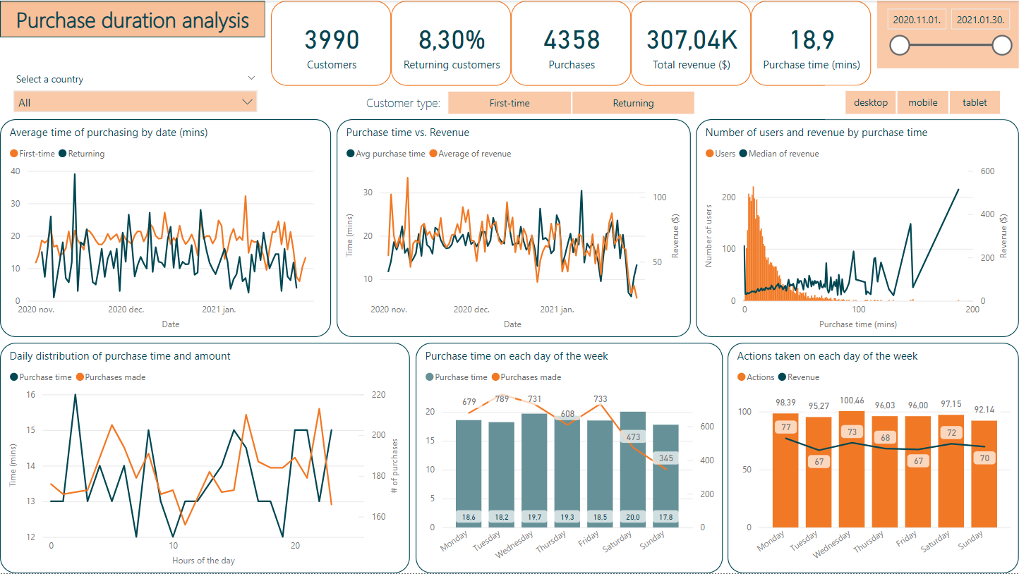
Dashboard

Slide 5
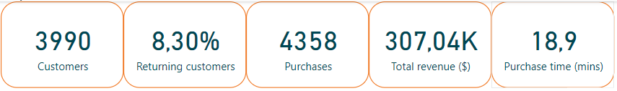
Main KPIs

Slide 6
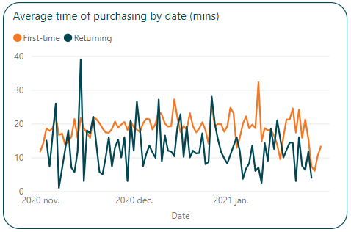
Purchase time
First-time customers spend more time on the website before purchasing
The peak in November is possibly due to a Black Friday promotion
Peak of first-timers in January
At the end of January pruchase time is decreasing

Slide 7
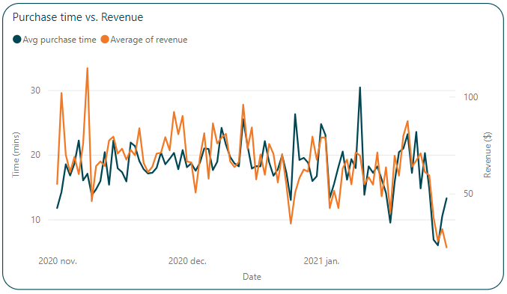
Purchase time vs revenue
Before the holidays there is an increase in revenue
After the holidays: increase in time but decrease in revenue
End of January: bigger drop in both values
Overall correlation is visible

Slide 8
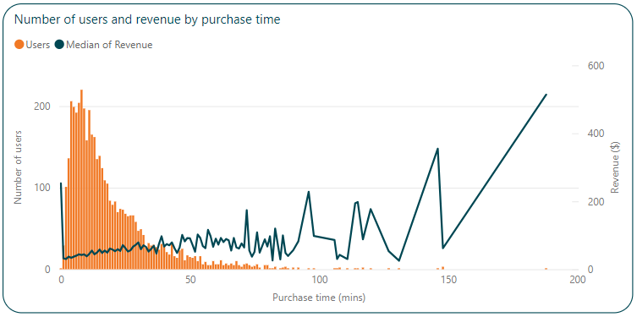
User and revenue distribution by purchase time
Users follow exponential distribution
Revenue increases with increased purchase time

Slide 9
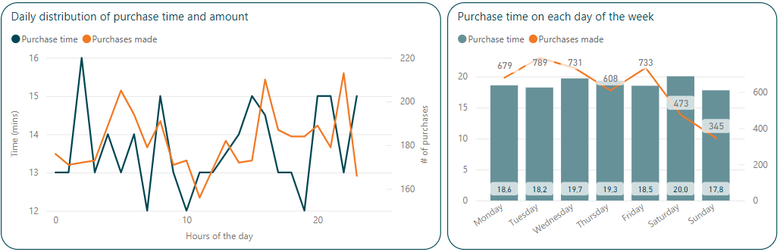
Daily and weekly distribution
During the day:
- highest activity: after working hours, late evening/night
- lowest activity: ~ lunch, dinner time
During the week:
- higher number of purchases mid-week
- lower number of purchases on the weekends
- highest purchase time is Wed & Sat

Slide 10
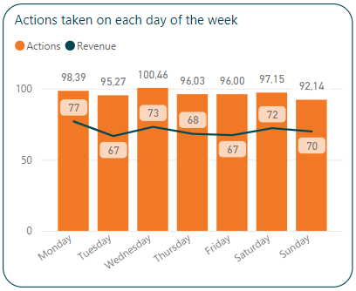
User and revenue distribution by purchase time
Strong correlation between actions taken by the customer and revenue (more items placed in cart etc)
Not many unnecessary actions (probaly items viewed are usually purchased

Slide 11
Conclusion
The average time customers spend on the website before purchasing is ~19 mins.
Slightly higher activity and purchase before the holidays, drop at the end of January.
On Wednesdays and Saturdays customers tend to spend more time before purchasing.
On the weekends there is lower amount of purchases.
During the day customers are more active early in the morning and in the evening.
Significant part of customers spend little amount of time (under 10 mins) before purchasing.
The more time customers spend on the website, the more purchases they make
Improvement:
Additional features on the site (linking products)
Analyze number of session before the actual purchasing session

